Slide 1

World Statistics Day
20.10.2010
Statisical Modelling of Complex Systems
Jouko Lampinen
Finnish Centre of Excellence in
Computational Complex Systems Research (COSY)
Department of Biomedical Engineering and Computational Science
Aalto University

Slide 2
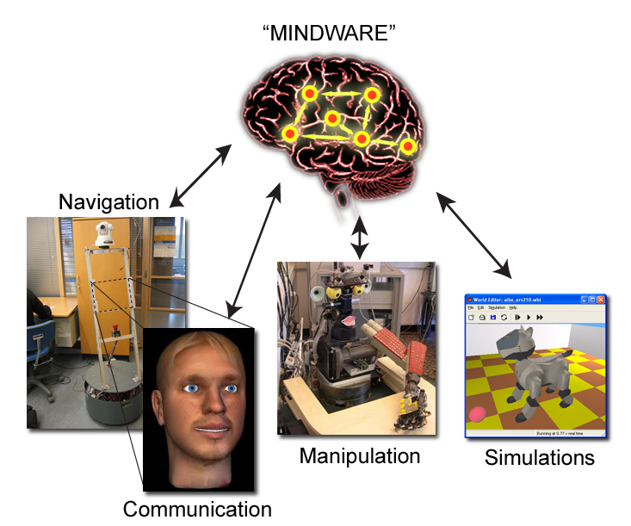
Complexity of a system:
Structure & Function & Response
Self-organisation – Emergent properties in
structure, function and response
Is complexity in number?
Six degrees - Small World
FRUIT FLY : 13600 genes
C. ELEGANS: 19500 genes
HOMO SAPIENS: 23300 genes
ARABIDOPSIS (mustard): 27000 genes
Communication system:
Many non-identical elements linked with diverse interactions
NETWORK
Notes:
2

Slide 3
How to?
Complex Dynamic Networks
characterizing the interaction structures and dynamical changes in large-scale systems with possibly very little prior knowledge
Bayesian Modelling
Modelling and estimating the interaction strengths and predicting the outcomes of partly known systems.
Notes:
3

Slide 4
Bayesian modelling
Complex phenomena need flexible models
Inference using Bayesian approach
  prior knowledge + observation -> posterior knowledge
Consistent approach for handling uncertainties, model selection, and prediction
Research issues: integration over large models, application specific models, model assessment
Applied in
Health care data analysis
Brain signal analysis
Object recognition
Notes:
4

Slide 5
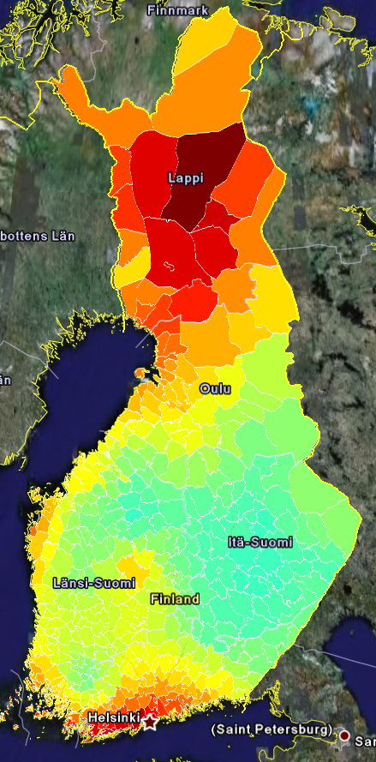
Spatial Epidemiology
Gaussian process smoothing
  different spatial correlation structures
  multible length-scales
  modelling of spatio-temporal effects
Variables of interest
  Spatial variation of diseases
  Practical efficacy of treatments
  Spatial distributon of demand and
  use of health care services
Algorithmic progress
  Basically O(N^3) ☹
  2006: 20 km grid, 600 cells: 2-3 days
  2009: 5 km grid, 10k cells: 2 hours

Slide 6
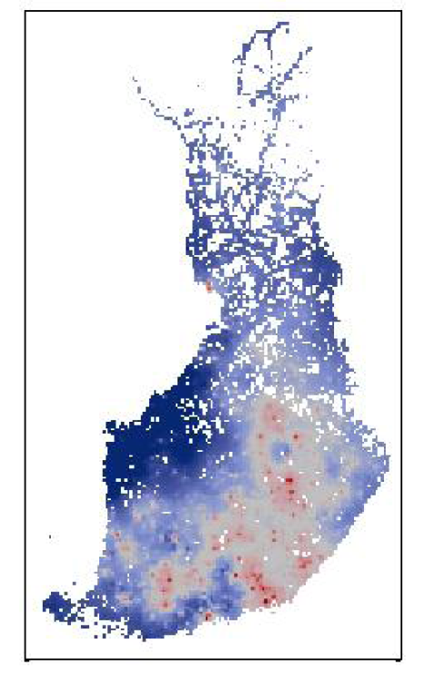
Example: Alcohol related mortality
Spatial variation of incidencies
Hypothesis: is risk elevated in population centers?
Notes:
6

Slide 7
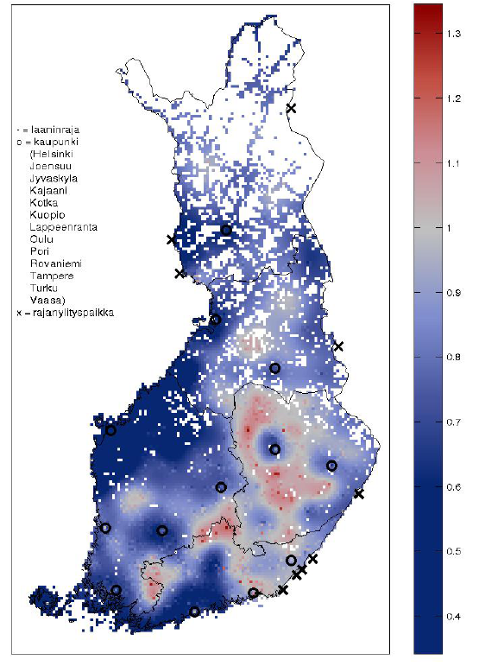
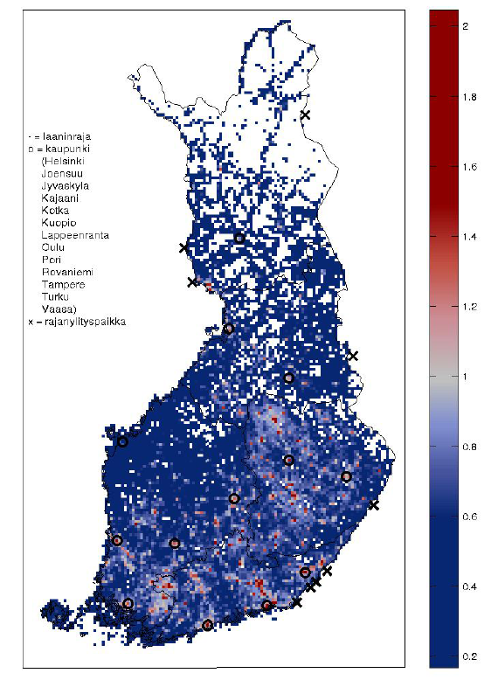
Alcohol related mortality
Spatial effect
Relative risk normalized for population
Notes:
7

Slide 8
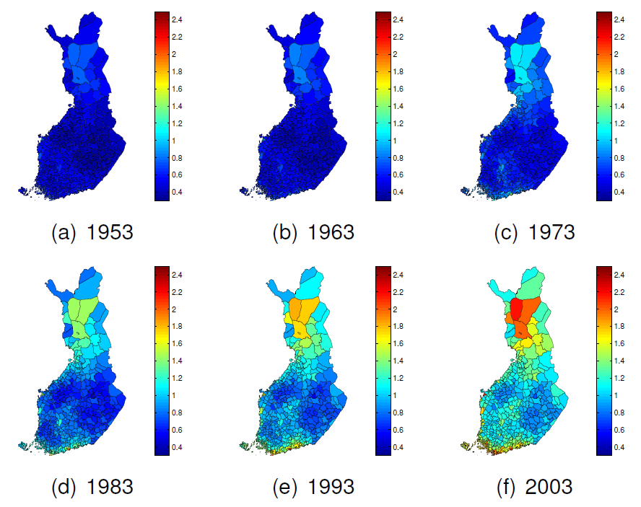
Spatio-temporal analysis of breast cancer (F)
Notes:
8

Slide 9
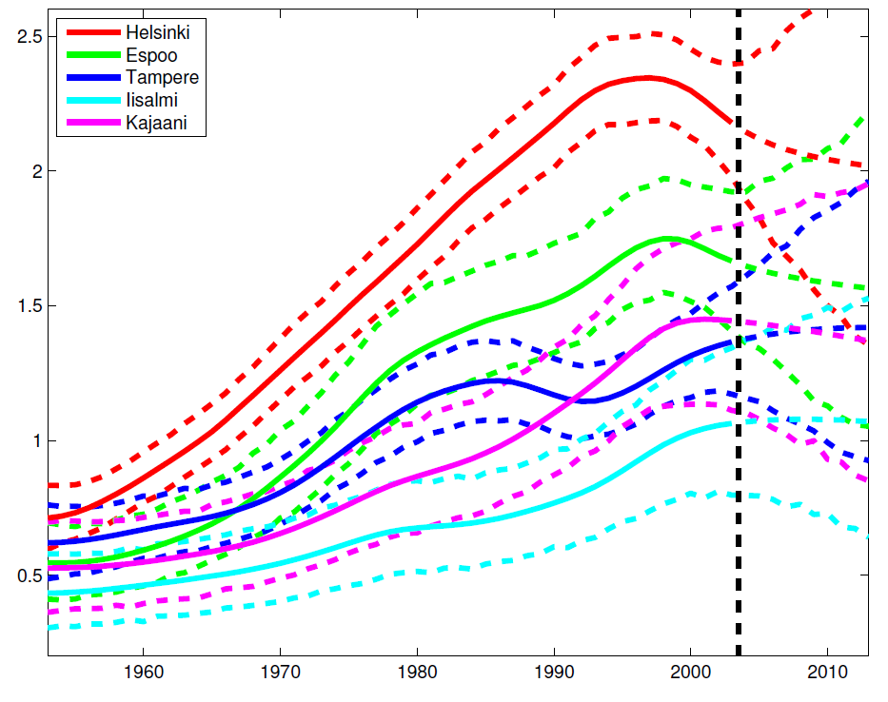
Prediction of breast cancer incidences
Collaboration with Finnish cancer Registry
Notes:
9

Slide 10
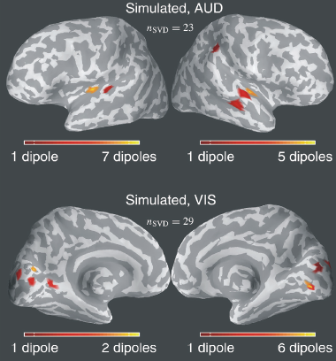
Brain Signal Analysis
Bayesian analysis of source localization in MEG
Current focus neurocinematics: spatio-temporal analysis of brain activity in natural stimulus environment

Slide 11
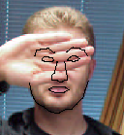
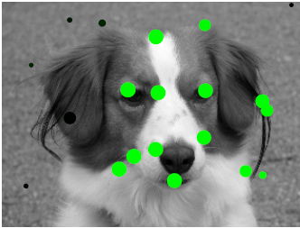
Bayesian Object Recognition
Perception as Bayesian Inference
perception = prior knowledge + sensory input
Object matching
  Sequential Monte Carlo
  Clutter, occlusions etc
Learning novel objects
  Population Monte Carlo

Slide 12
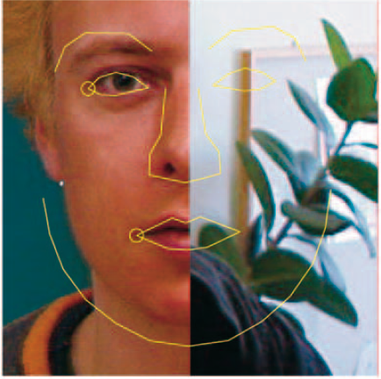
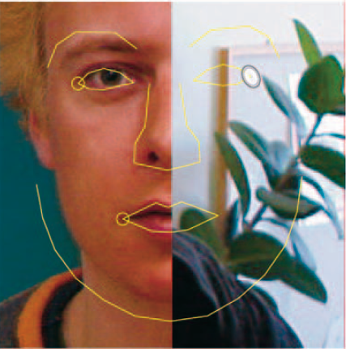
Adaptive proposal distribution in SMC
Example of proposal distributions for new feature
Feature with good likelihood
Occluded feature with no information in likelihood

Slide 13
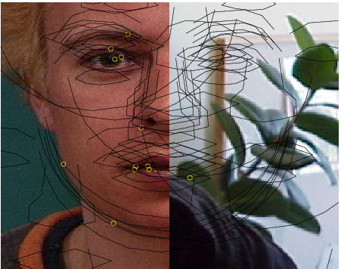
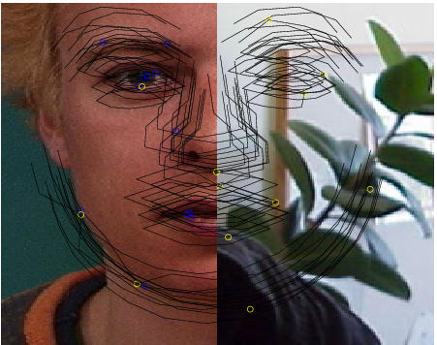
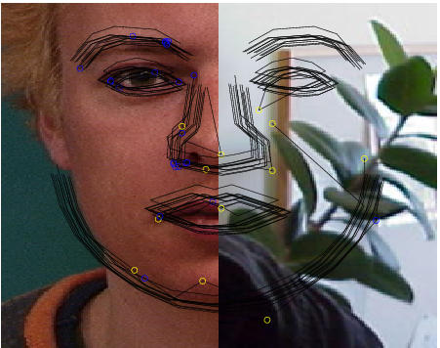

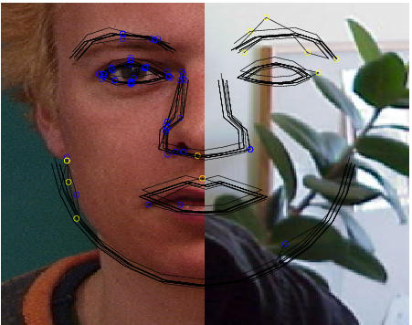
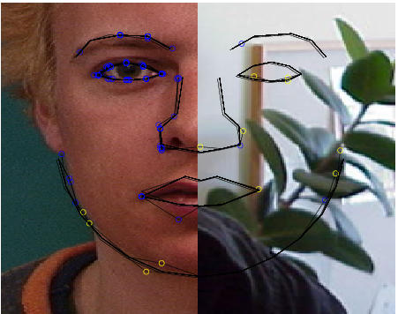




Example of SMC sampling
Sequential sampling with random feature order and occlusion model
Final match
Blue – already sampled, yellow – new feature

Slide 14
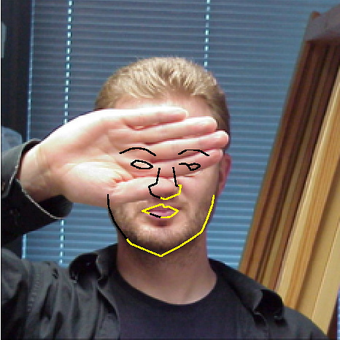
Example of SMC sampling with occlusions
Model trained with studio quality images
Test image in uncontrolled office environment
Posterior means
yellow: p(visibility)>0.5
black: p(visibility)<0.5

Slide 15
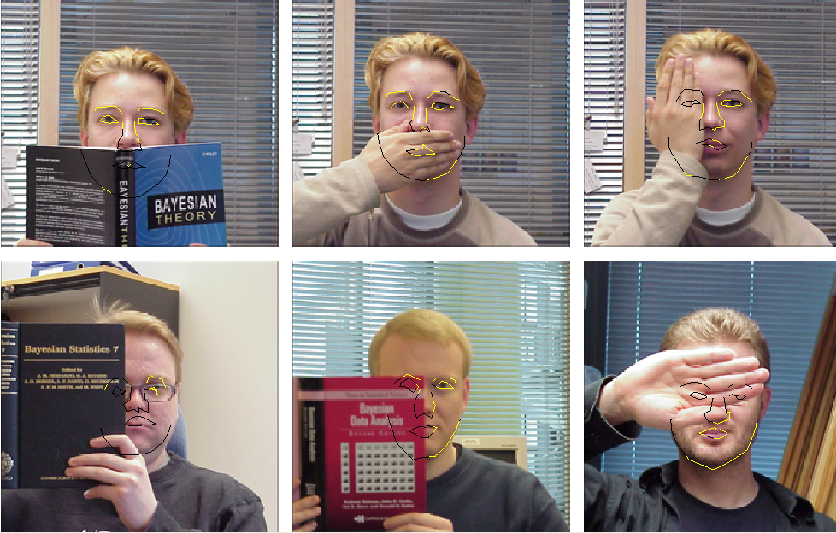
Example of SMC sampling with occlusions

Slide 16
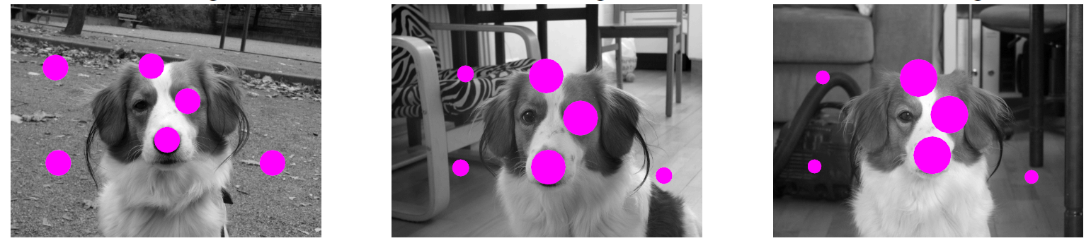
Learning novel objects
Based on the previous occlusion model for detecting background feature points
Population Monte Carlo for adapting likelihood and shape parameters and
the probability of the feature belonging to the object

Slide 17
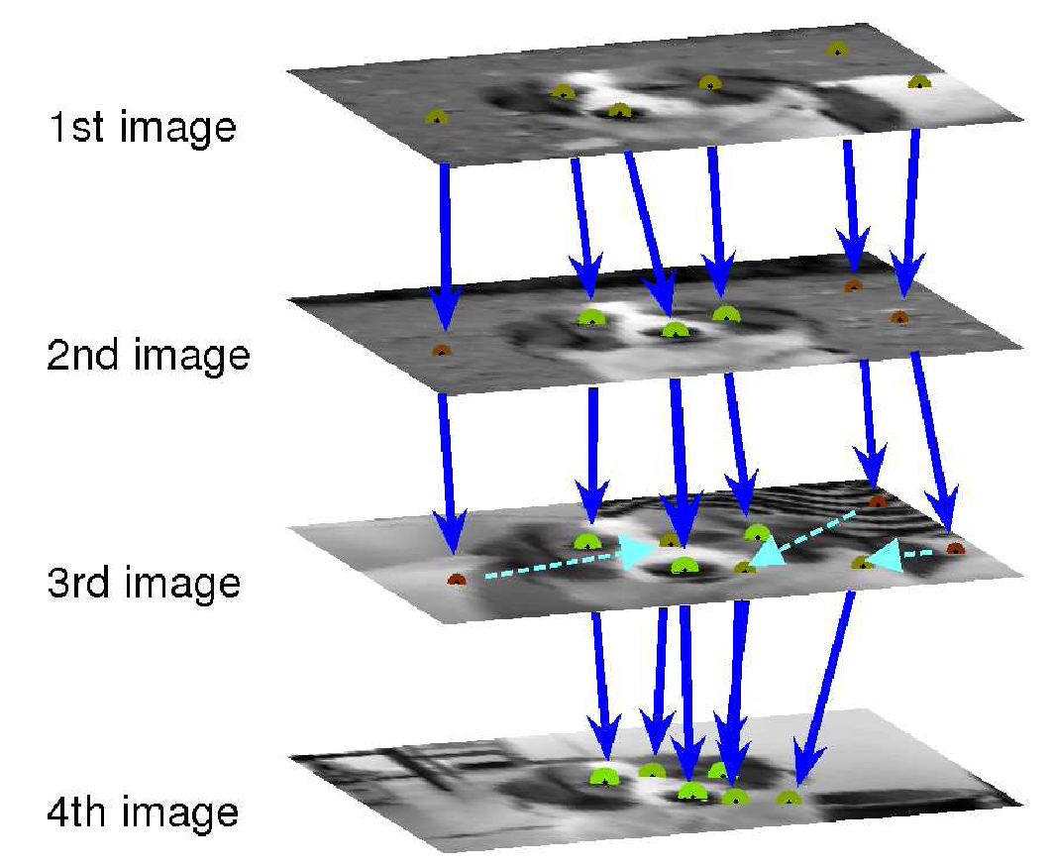
Learning novel objects
Matching:
predicted position + likelihood =>
posterior position & association
Resampling:
the most probable hypotheses
are retained
For additional info: PhD dissertation of Miika Toivanen,
"Incremental object matching with probabilistic methods"
on October 22nd, 2010 at 12 o’clock, Hall F239a
Opponent: Dr. Josephine Sullivan, KTH, Sweden

